Slide 1
Simple Review
Heap Sort
  Heaps
  MAX-HEAPIFY
  BUILD-MAX-HEAP
  HEAPSORT
Priority Queues
  MAXIMUM(S)
  EXTRACT-MAX(S)
  INCREASE-KEY(S,x,k)
  INSERT(S, x)
  Applications

Slide 2
Design and Analysis of Algorithms
Quicksort (Ch7)

Slide 3
Design and Analysis of Algorithms
Quicksort
Topics:
Quicksort
Randomized quicksort algorithms

Slide 4
Randomized algorithm
Randomized algorithms: algorithms that flip coins
--Applications
>>Quicksort
>>Discovering common motif in DNA sequence in computational biology
Algorithms that make random decisions
That is:
--Can generate a random number x from some range {1,r}
--Make decisions based on the value of x
Why would it make sense?
Notes:
Motif：主题, 主旨, 动机, 图形

Slide 5

Two cups, one coin
If you always choose a fixed cup, the adversary will put the coin in the other one, so the expected payoff=$0
If you choose a random cup, the expected payoff=$0.5
Notes:
Adversary：敌手, 对手

Slide 6
Randomized algorithm
Two basic types:
--Typically fast (but sometimes slow): Las Vegas
--Typically correct (but sometimes output garbage): Monte Carlo
The probabilities are defined by the random numbers of the algorithm! (not by random choices of the problem instances)

Slide 7
Quicksort
Efficient sorting algorithm
--Proposed by C.A.R. Hoare in 1962
--Divide-and-Conquer algorithm
--Sorts “in place” (like insertion sort, but not like merge sort)
--Very practical (with tuning)
--Can be viewed as a randomized Las Vegas algorithm
--Worst-case running time: Θ(n²)
--Expected running time: Θ(nlogn)
--Constant hidden in Θ(nlogn) are small.

Slide 8
Divide and Conquer
Quicksort an n-element array:
--Divide: Partition the array into two subarrays around a pivot x such that elements in lower subarray≤x≤ elements in upper subarray
--Conquer: Recursively sort the subarrays.
--Combine: Trivial.
Key: Linear-time partitioning subroutine.
Notes:
枢轴, 支点, (讨论的)中心点, 重点

Slide 9
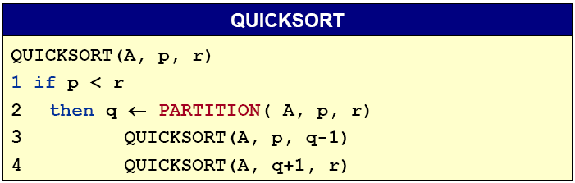
Divide and Conquer
Initial call Quicksort(A, 1, n)

Slide 10
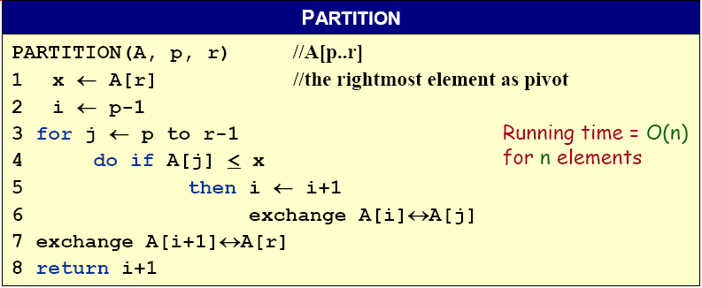
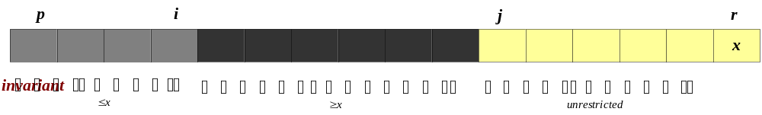
Partitioning subroutine
A[p,…,i]:known to be ≤ pivot
A[j…r]:not yet examined
A[i+1,…,j-1]:known to be > pivot
A[r]:pivot
Notes:
Pivot：枢轴, 支点, (讨论的)中心点, 重点

Slide 11










Example of Partitioning
The operation of Partition on a sample array. Lightly shaded array elements are all with values no greater than x (the pivot). Heavily shaded array elements are all with values greater than x.

Slide 12
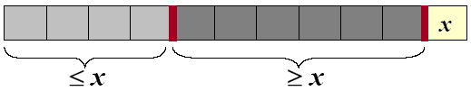
Analysis of quicksort
Assume all input elements are distinct.
In practice, there are better partitioning algorithms for when duplicate input elements may exist.
Let T(n) = worst-case running time on an array of n elements.

Slide 13
Worst-case of quicksort
Input sorted or reverse sorted.
Partition around min or max element.
One side of partition always has no elements.
T(n) = T(n - 1) + T(0) + Θ(n)
= T(n - 1) + Θ(1) + Θ(n)
= T(n - 1) + Θ(n)
= Θ(n²) (Arithmetic series)

Slide 14
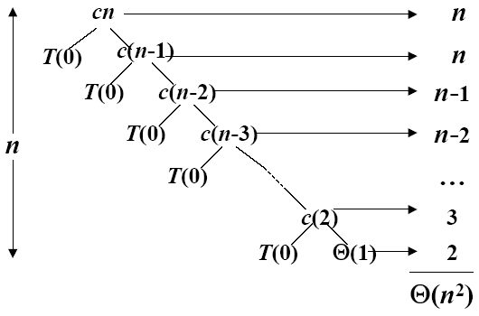
Worst-case recursive tree
T(n) = T(n - 1) + T(0) + Θ(n)
A recursion tree for QUICKSORT in which the Partition procedure always puts only a single element on one side of the partition (the worst case). The resulting running time is Θ(n²)

Slide 15
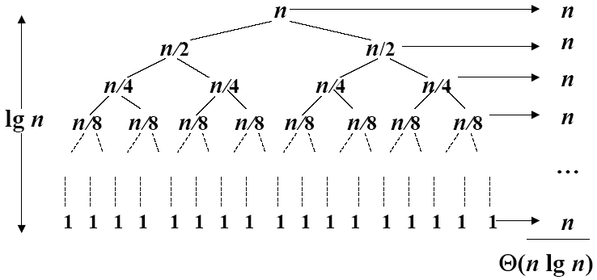
Best Case Partitioning
Θ(nlgn)
A recursion tree for QUICKSORT in which the Partition always balances the two sides of the partition equally (the best case). The resulting running time is Θ(nlgn)

Slide 16
Best-case analysis
If we’re lucky, PARTITION splits the array evenly:
--T(n) = 2T(n/2) + Θ(n) = Θ(nlogn).
What if the split is always 1/10:9/10?
--T(n) ≤ T(9n/10) + T(n/10) + Θ(n)
--What is the solution to this recurrence?
Notes:
Evenly：均匀地

Slide 17
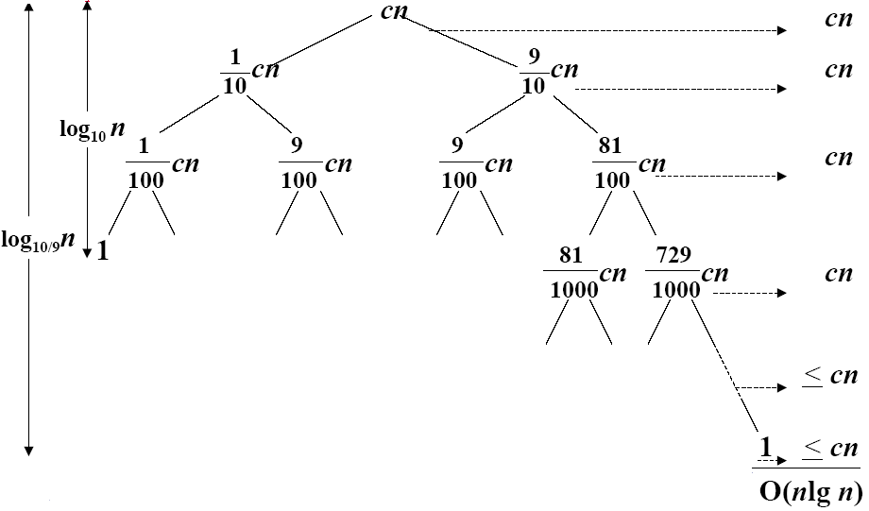
A Recursion tree
Worst case Θ(n²), why we prefer Quicksort to Mergesort
A recursion tree for QUICKSORT in which PARTITION always produces a 9-to-1 split, yielding a running time of O(n lgn)

Slide 18
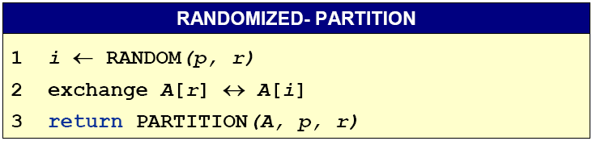
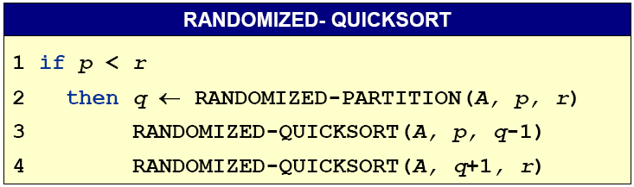
Randomize-Partitioning

Slide 19
Randomized quicksort
Partition around a random element, i.e., around A[t], where t chosen uniformly at random from {p…r}
expected time is O(n lgn)
Notes:
Uniformly：一律地

Slide 20
Quicksort VS. Mergesort
Which is better?
Test environment:
  IBM370/158
  Programming in PL/1
  Input consists of random integers range in (0, 10000)
n 1000 1500 2000 2500 3000 3500 4000 4500
MERGESORT 500 750 1050 1400 1650 2000 2250 2650
QUICKSORT 400 600 850 1050 1300 1550 1800 2050
n 5000 5500 6000 6500 7000 7500 8000 8500
MERGESORT 2900 3450 3500 3850 4250 4550 4950 5200
QUICKSORT 2300 2650 2800 3000 3350 3700 3900 4100

Slide 21
Homework
7.2-2

